Slide 1
Complete binary trees

Slide 2
Outline
Introducing complete binary trees
Background
Definitions
Examples
Logarithmic height
Array storage

Slide 3
Background
5.3
A perfect binary tree has ideal properties but restricted in the number of nodes: n = 2^{h + 1} – 1 for h = 0, 1, …
1, 3, 7, 15, 31, 63, 127, 255, 511, 1023, ....
We require binary trees which are
Similar to perfect binary trees, but
Defined for all n

Slide 4
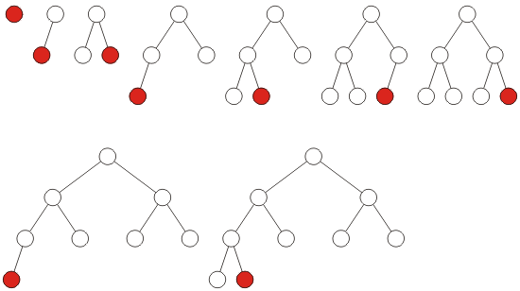
Definition
5.3.1
A complete binary tree filled at each depth from left to right:

Slide 5
Definition
5.3.1
The order is identical to that of a breadth-first traversal

Slide 6
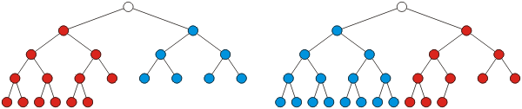
Recursive Definition
5.3.1
Recursive definition: a binary tree with a single node is a complete binary tree of height h = 0 and a complete binary tree of height h is a tree where either:
The left sub-tree is a complete tree of height h – 1 and the right sub-tree is a perfect tree of height h – 2, or
The left sub-tree is perfect tree with height h – 1 and the right sub-tree is complete tree with height h – 1

Slide 7
Height
5.3.2
Theorem
The height of a complete binary tree with n nodes is h = ⌊lg(n)⌋
Proof:
Base case:
When n = 1 then ⌊lg(1)⌋ = 0 and a tree with one node is a complete tree with height h = 0
Inductive step:
Assume that a complete tree with n nodes has height ⌊lg(n)⌋
Must show that ⌊lg(n + 1)⌋ gives the height of a complete tree with n + 1 nodes
Two cases:
If the tree with n nodes is perfect, and
If the tree with n nodes is complete but not perfect

Slide 8
Height
5.3.2
Case 1 (the tree is perfect):
If it is a perfect tree then
Adding one more node must increase the height
Before the insertion, it had n = 2^{h + 1} – 1 nodes:
Thus,
However,

Slide 9
Height
5.3.2
Case 2 (the tree is complete but not perfect):
If it is not a perfect tree of height h then
Consequently, the height is unchanged: ⌊lg( n + 1 )⌋ = h
By mathematical induction, the statement must be true for all n ≥ 1

Slide 10
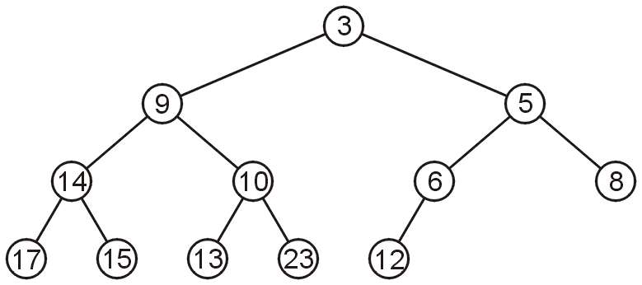
Array storage
5.3.3
We are able to store a complete tree as an array
Traverse the tree in breadth-first order, placing the entries into the array

Slide 11
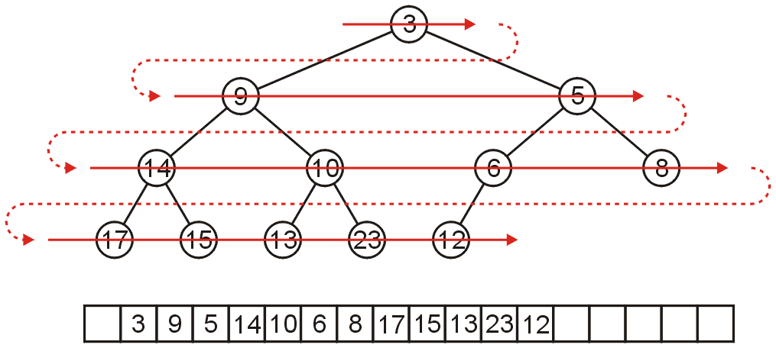
Array storage
5.3.3
We can store this in an array after a quick traversal:

Slide 12
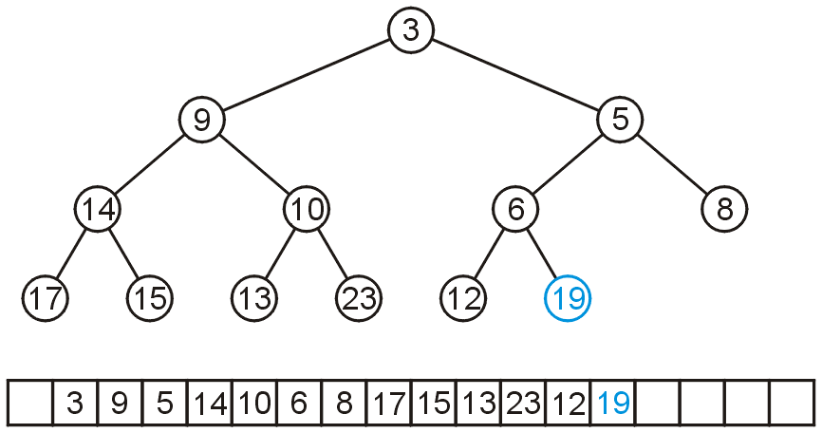
Array storage
5.3.3
To insert another node while maintaining the complete-binary-tree structure, we must insert into the next array location

Slide 13
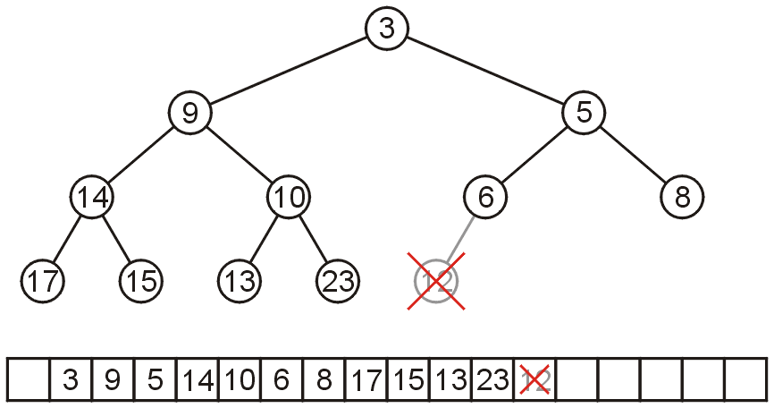
Array storage
5.3.3
To remove a node while keeping the complete-tree structure, we must remove the last element in the array

Slide 14
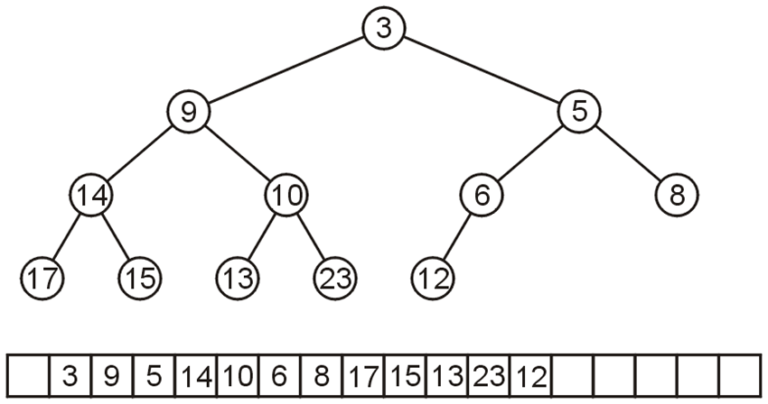
Array storage
5.3.3
Leaving the first entry blank yields a bonus:
The children of the node with index k are in 2k and 2k + 1
The parent of node with index k is in k ÷ 2
0 1 2 3 4 5 6 7 8 9 10 11 12 13 14 15 16 17

Slide 15
Array storage
5.3.3
Leaving the first entry blank yields a bonus:
In C++, this simplifies the calculations:
parent = k >> 1;
left_child = k << 1;
right_child = left_child | 1;
0 1 2 3 4 5 6 7 8 9 10 11 12 13 14 15 16 17

Slide 16
Array storage
5.3.3
For example, node 10 has index 5:
Its children 13 and 23 have indices 10 and 11, respectively
0 1 2 3 4 5 6 7 8 9 10 11 12 13 14 15 16 17

Slide 17
Array storage
5.3.3
For example, node 10 has index 5:
Its children 13 and 23 have indices 10 and 11, respectively
Its parent is node 9 with index 5/2 = 2
0 1 2 3 4 5 6 7 8 9 10 11 12 13 14 15 16 17

Slide 18
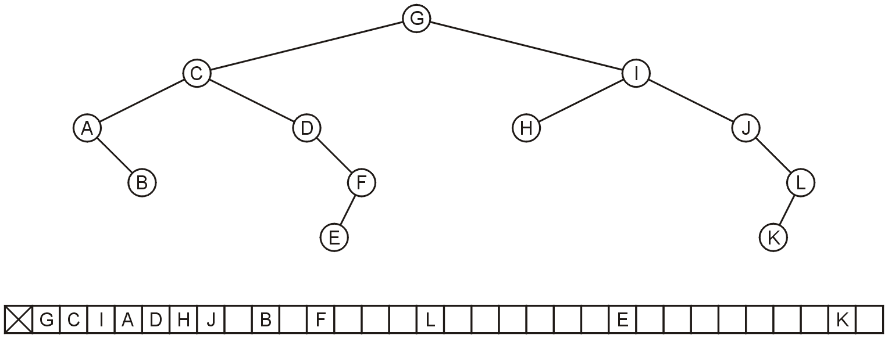
Array storage
5.3.4
Question: why not store any tree as an array using breadth-first traversals?
There is a significant potential for a lot of wasted memory
Consider this tree with 12 nodes would require an array of size 32
Adding a child to node K doubles the required memory

Slide 19
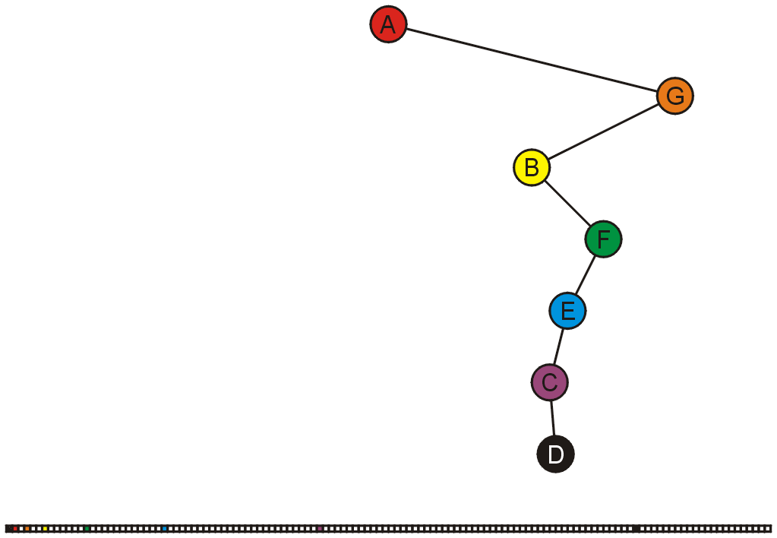
Array storage
5.3.4
In the worst case, an exponential amount of memory is required
These nodes would be stored in entries 1, 3, 6, 13, 26, 52, 105

Slide 20
Summary
In this topic, we have covered the concept of a complete binary tree:
A useful relaxation of the concept of a perfect binary tree
It has a compact array representation

Slide 21
Usage Notes
These slides are made publicly available on the web for anyone to use
If you choose to use them, or a part thereof, for a course at another institution, I ask only three things:
that you inform me that you are using the slides,
that you acknowledge my work, and
that you alert me of any mistakes which I made or changes which you make, and allow me the option of incorporating such changes (with an acknowledgment) in my set of slides
Sincerely,
Douglas Wilhelm Harder, MMath
dwharder@alumni.uwaterloo.ca

